Slide 1
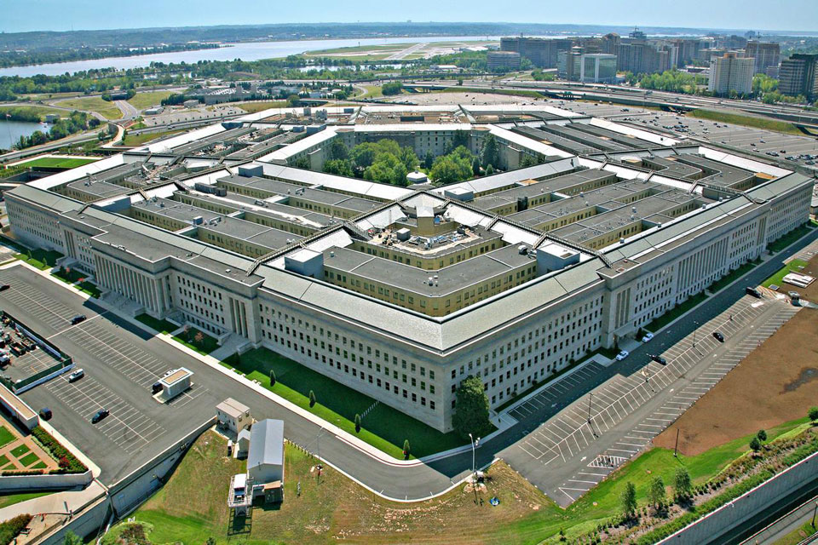
US Department of Defense
Pentagon
Information provided in this talk is derived from publicly available
information on internet and YouTube.

Slide 3
Countries with the highest military spending worldwide (2020) (in billion U.S. dollars)
https://www.statista.com/statistics/262742/countries-with-the-highest-military-spending/

Slide 4
In 2018, military expenditure as a percentage of GDP
United States 3.2%
China 1.9%,
Russia 3.9%,
France 2.3%,
United Kingdom 1.8%,
India 2.4%,
Israel 4.3%,
South Korea 2.6%
Germany 1.2%

Slide 5
Ford Class Aircraft Carrier
Type | Aircraft carrier
Displacement | About 100,000 long tons (100,000 tonnes) (full load)^{[4]}
Length | 1,092 ft (333 m)
Speed | 35 knots
Height | 250 feet (76 m)^{[citation needed]}
Draft | 39 ft (12 m)^{[6]}
Beam | 252 ft (77 m) (flight deck) 134 ft (41 m) (waterline)
https://en.wikipedia.org/wiki/Gerald_R._Ford-class_aircraft_carrier

Slide 6
Aircraft Carrier
https://en.wikipedia.org/wiki/Gerald_R._Ford-class_aircraft_carrier
Scary USS Gerald R. Ford - How Powerful is the CVN-78? US Navy's $13 Billion Aircraft Carrier
https://www.youtube.com/watch?v=sJdHh5zn8Zw
US Build A New Aircraft Carrier The World Afraid Of
https://www.youtube.com/watch?v=Xq8bb0U0WhM&t=317s
List of aircraft carriers of the world
https://en.wikipedia.org/wiki/List_of_aircraft_carriers

Slide 7
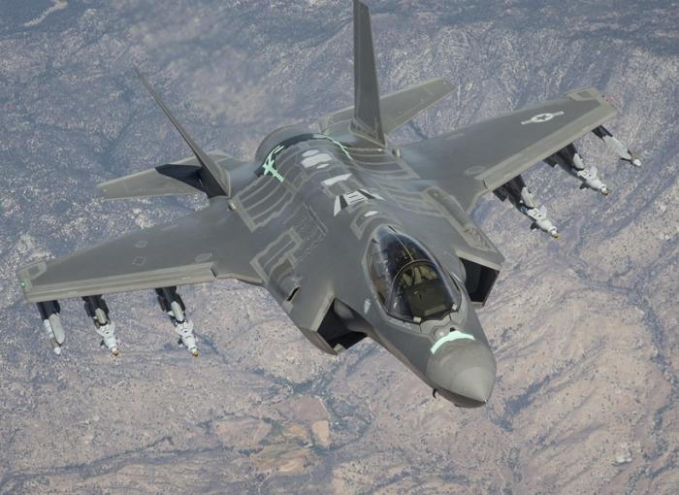
F-35 Joint Strike Fighter

Slide 8
F-35 Joint Strike Fighter- Lightning II
Take off and Landing on an Aircraft Carrier
https://www.youtube.com/watch?v=kJswaDq-9iA
https://www.youtube.com/watch?v=zW28Mb1YvwY&t=2s
F-35B STOVL Transition, Hover, and Return To Forward Flight - Farnborough Airshow
https://www.youtube.com/watch?v=vsKwBzt7rDY

